Slide 1
Open Meetings Act
NMSA 1978, Sections 10-15-1 to -4
June 22, 2021
New Mexico Commission for the Blind
State Rehabilitation Council
Assistant Attorney General
John Kreienkamp
Open Government Division
New Mexico Office of the Attorney General

Slide 2
About the Open Government Division
Office of the Attorney General Structure: Civil Affairs & Criminal Affairs
  OGD is within Civil Affairs
Represent approximately 80 state boards and commissions
Have a variety of functions:
  Client representation
  Contract review
  Draft Official Attorney General Opinions
  Bill analysis
  Other duties as assigned
  Enforce Open Meetings Act (OMA) and Inspection of Public Records Act (IPRA)

Slide 3
This Presentation
30 minute overview of OMA
  Who and what is subject to OMA?
  Notices
  Agendas
  Minutes
Not a full training, leaving out:
  Procedures for closed session
  Exceptions to go into closed session
Focus on what members need to know

Slide 4
OMA as Public Policy
Public is entitled to greatest possible information about government affairs
Representative government depends on informed electorate
All meetings of a public body are public meetings
  Anyone can “attend and listen”
  No closed meetings for formation of public policy or conduct of business by vote
Section 10-15-1(A)

Slide 5
Who and what is subject to OMA?
“Public body”= very broad definition
  Must be multi-member, policymaking
  Not purely advisory bodies, unless created by statute
OMA applies to all meetings of a quorum held to:
  Formulate public policy
  Discuss public business
  Take any action
OMA does not apply when public body is not discussing public business
Keep in mind:
  Committees are subject to OMA when they wield policymaking authority
  Avoid rolling quorums
  Meetings of quorum can go by many names (work session, retreat, etc.)
Section 10-15-1(B)

Slide 6
Examples
The Public Regulation Commission is a full-time salaried commission regularly engaged in the conduct of public business, i.e., utility rate regulation. The PRC holds a special meeting for the purposes of discussing public business, but takes no action at the meeting. Is the meeting subject to OMA, requiring notice, agenda, minutes, etc.?
Two members of a three-member school board attend the retirement party of the District’s longtime superintendent. While at the party, the Board members discuss the basketball playoffs. After the meeting, one of these Board members sends a text message to the other urging him to vote in favor of the proposed budget at the next meeting. The other Board member texts back that he will vote in favor of the budget. Was this a violation of OMA?

Slide 7
Meeting Notices - Generally
Reasonable advance notice of all meetings
  Applies to both open and closed meetings
  No secret meetings
All public bodies must determine reasonable notice once per year
  Custom is to adopt annual OMA resolution
Must include:
  Date, time, and location
  Agenda (or how to get a copy)
Provided to, at minimum:
  Published or posted in place and manner accessible to the public
  Broadcast stations and newspapers of general circulation that make a written request for notice
  Other requirements found by the public body to be reasonable
Section 10-15-1(D)

Slide 8
Meeting Notices: General Deadlines
Regular meetings
  Notice: at least 10 days
  Agenda: at least 72 hours
Special meetings
  Notice: at least 3 days
  Agenda: at least 72 hours
Emergency meetings
  Only allowed if significant threat to public health, safety, or imminent and irreparable financial harm to public body
  Notice and agenda = 24 hours or less depending on emergency
Section 10-15-1(D)

Slide 9
Agendas
Meeting notice must include agenda (or information on how to get a copy)
Must contain a list of specific items of business
  Must be reasonably specific
No action may be taken at a meeting unless the item appears on final agenda
  Posted 72 hours in advance
  Exception for emergency meetings
Section 10-15-1(F)

Slide 10
Agendas: Timing
Must be posted at least 72 hours before a meeting
Must be on website
  If public body has one
  Again, 72 hours in advance
Exception: public bodies that meet more than once a week
  Draft agenda: 72 hours before a meeting
  Final agenda: 36 hours before a meeting
Section 10-15-1(B)

Slide 11
Example
School Board Agenda
123 Fictitious Ave.,
Santa Fe, NM
May 23, 2021
5:00 PM
Call to order
Approval of Meeting Agenda
Approval of Minutes from March 4, 2021 Meeting
Old Business
New Business
  Vending machines in the cafeteria
  Limited personnel matters
Adjourn
The Board discusses and acts on three contracts. Was this agenda item reasonably specific?
The Board discusses and votes to allow vending machines in the school cafeteria. Was this agenda item reasonably specific?
The board dismisses the director of the district’s administrative office and reorganizes the remaining staff positions. Was this agenda item reasonably specific?
OMA Guide, Ex. 26

Slide 12
Minutes
Must keep minutes of all meetings
At minimum, must include:
  Date, time, and place
  Names of members present and absent
  Substance of proposals considered
  Record of decisions made and any votes
Voting: how each member voted
  No secret ballots
Section 10-15-1(G)

Slide 13
Minutes: Timing
Minutes are available for inspection
  Includes draft minutes
  Even if not yet approved by public body
Draft minutes must be prepared in 10 working days
Must be considered at next meeting
  Including special meetings, work sessions, retreats, etc.
Subject to IPRA
Section 10-15-1(G)

Slide 14
Open Meetings and COVID-19
Generally, public bodies must meet in person
  COVID-19 pandemic is an exception to the rule
Can meet virtually or telephonically during the state of emergency
Attorney General’s Guidelines:
  Provide alternative means of attendance to public (virtual or telephonic)
  Announce members of public body participating remotely
  All members must be audible when speaking
  Suspend discussion when audio/video interrupted
  All votes by roll call vote
  Produce and maintain a recording of the meeting
Section 10-15-1(C)

Slide 15

Enforcement: Civil and Criminal
Attorney General and District Attorneys
Private individuals
  Written notice to public body required; public body has 15 days to act on alleged violation
  Individual can recover reasonable costs & attorneys’ fees
Actions taken in violation of Act may be deemed invalid
  Presumption: public body complied with OMA
Criminal sanction: violation
of OMA is full misdemeanor
  Punishable by up to $500
  per violation

Slide 16
In Review
Any meeting of quorum where public business is discussed is a meeting subject to OMA
  Even if you call it a retreat or work session
Avoid “rolling quorums”
Agendas must be reasonably specific

Slide 17
Questions?
Consult your attorney
Attorney General Open Meetings Act and Inspection of Public Records Act Compliance Guides, www.nmag.gov
NM Attorney General’s Office
  Open Government Division, (505) 490-4060
NM Foundation for Open Government
  www.nmfog.org

Slide 18
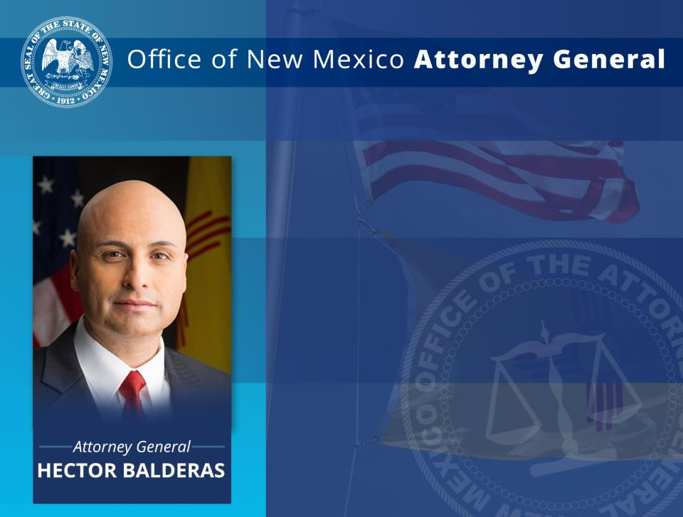
408 Galisteo St.,
Santa Fe, NM 87501 www.nmag.gov
CIVIL AFFAIRS: Open Government Division
(505) 490-4060
For copies of this presentation, please email:
Heather Sandoval, hsandoval@nmag.gov

